Slide 1





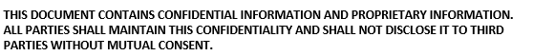
COMESA Digital Retail Instant Payments Platform
Proof of Concept
Zambia-Malawi Trade Corridor

Slide 2
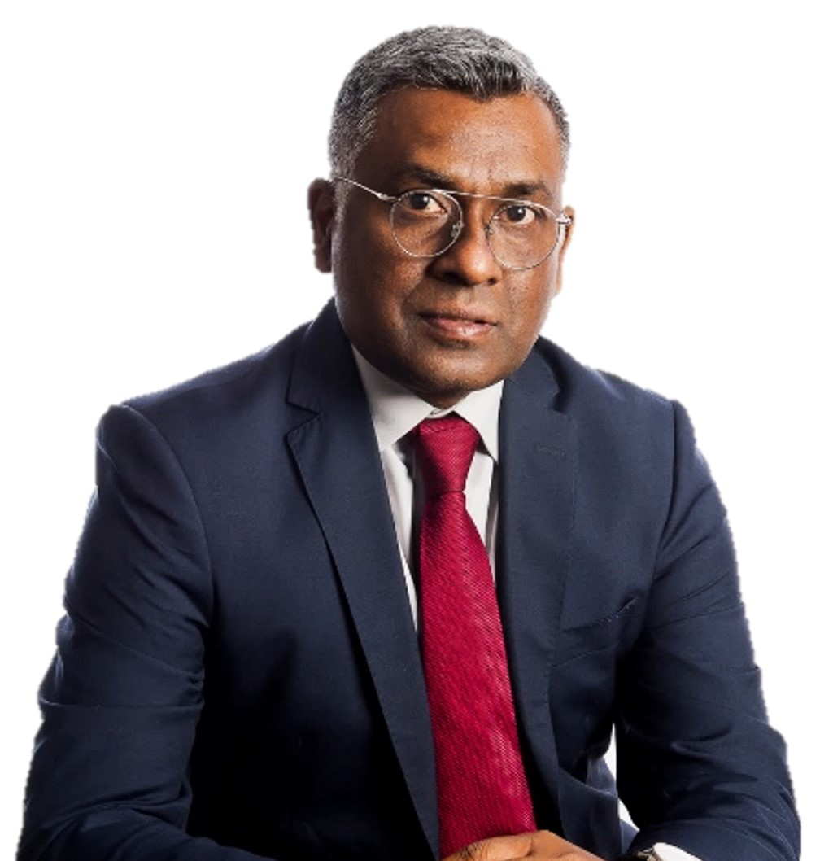


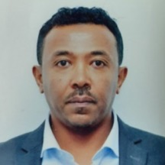
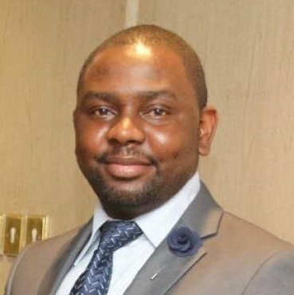

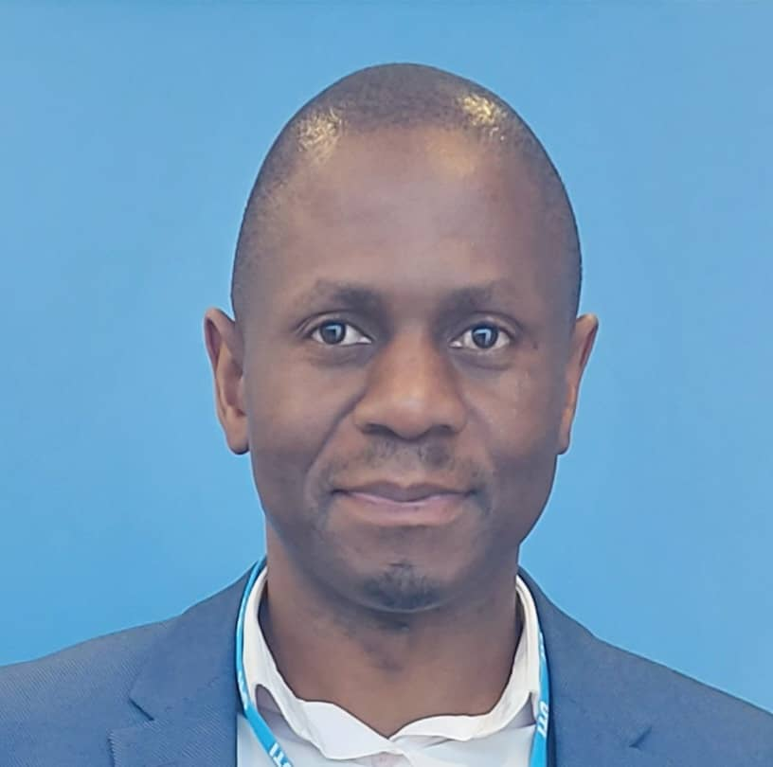
Leadership Team
CBC
Chief Executive Officer
DFI Advisory Committee;
Airtel, Vodacom, KCB, Bank of Zambia, Kenya Bankers Association, Bankers Association of Zambia, GSMA, Bayer, Coca Cola, Technobrain, MSME representative, FDH, Ethio Switch
Operations Management Team
Chief Operating Officer
Dr Jonathan Pinifolo
Chief Information Officer
Mr Yoseph Wondimu
Manager - Business Dev. & Participants
Mr Hopewell Musundire
Manager - Marketing & Product Innovation
Ms Marianne Nzioki
Regulatory Affairs Officer
Mr John Jailosi

Slide 3






Key Stakeholders in the POC
Bank of Mauritius
Designated Settlement Financial Institution
Project Sponsor
Technical Consultant
Technical Implementation Partner
Open-source, Push Payment Technology
COMESA Clearing House (CCH)
The Common Market for Eastern and Southern Africa

Slide 4












Committed Participants in the Programme

Slide 5
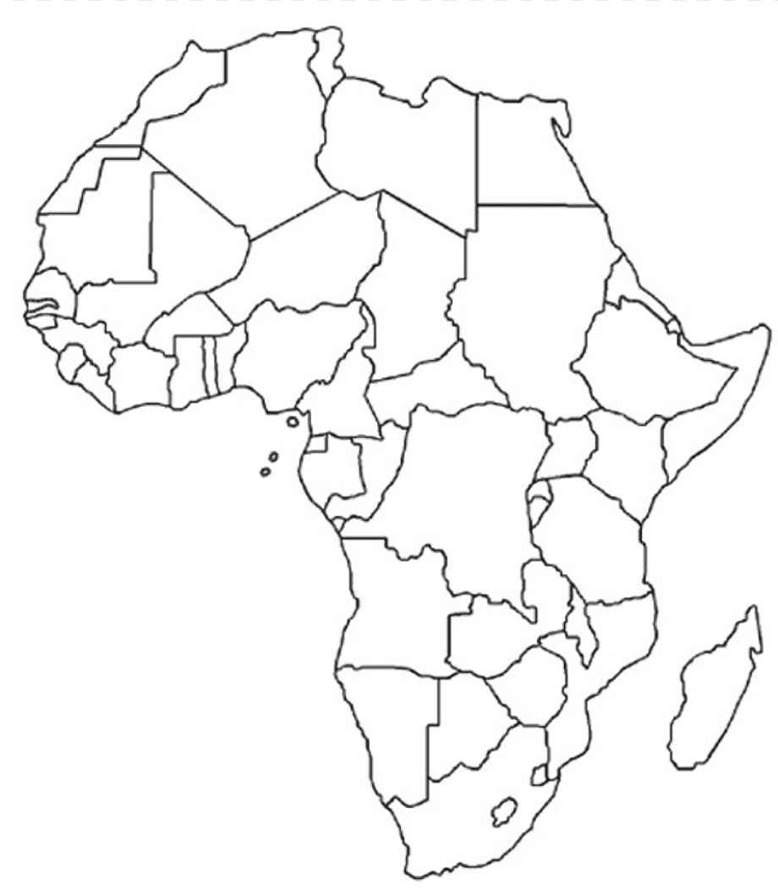
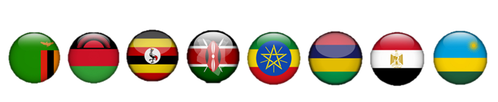
Digital Financial Inclusion for MSMEs in COMESA Region
Pilot program in 8 of the 21 COMESA
Member States
Zambia, Malawi, Uganda, Kenya,
Ethiopia, Mauritius, Egypt, Rwanda.
5

Slide 6






Digital Financial Inclusion for MSMEs in COMESA Region
Project Background The MSME Digital Financial Inclusion Project’s overall goal is to support the development of a Regional Digital Retail Instant Payments Platform that serves Micro Small and Medium Enterprises (MSMEs) in COMESA Region thereby improving cross border trade.
Key features
Low-cost (affordable)
Interoperable
Fraud resistant
Focus on MSMEs
Focus on women and youth
Expected Outcome
Enhanced Financial Inclusion
Participation of MSMEs in formal regional trade
Increased volumes of cross border transactions
Increased visibility of African products within regional markets
Directly respond to the intra-trade deficit in the region

Slide 7
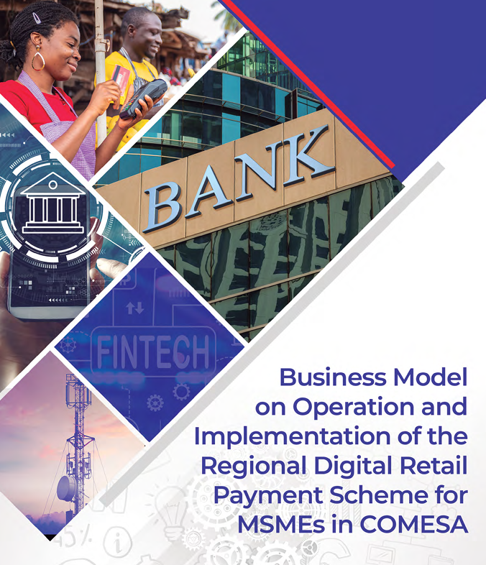
Journey of CBC’s Digital Financial Inclusion Program for MSMEs
Business Case Development
Jan 2021
Business Model First Validation
Dec 2021
Business Model Final Validation
March 2022
Technical Feasibility
October 2023
Technical Feasibility
October 2023
Commercial Deployment
P2P and P2B
Expected 2024
Additional Use Cases
Design and Implement Technical POC utilising Mojaloop Tech
Gather feedback from potential market participants (MFIs, Banks, MNOs,Regulators etc)
Propose actionable recommendations & a well-defined roadmap for the full-scale implementation
Business-Model-Report.pdf (comesabusinesscouncil.org)

Slide 8
Design: Ultimate Vision vs. Technical POC
COMESA Digital Retail Instant Payment Platform
Design Decision​ | Ultimate Vision ​ | Technical POC
Countries​ | Connecting the entire COMESA region​ | Malawi - Zambia​
Policy environments​ | Accommodate the significant differences found either through policy harmonization or by identification of an appropriate service level that is included in the Rulebook​ | Relatively harmonized - requirements will be specified in the Rulebook​
Integration Model​ | Fully centralized regional system​ | Fully centralized regional system​
Scheme Manager and Operator​ | COMESA Participant Association with a Single operator-to be appointed by the Scheme Manager​ | CBC supported by the system implementation​ team ​
Use Cases​ | P2P, P2P with RTP, P2B, B2B and ecommerce (potentially others)​ | Account to Account​
System Capabilities​ | Clearing, Settlement, FX, Fraud​ Management, Dispute Management, Open API management, Proxy Lookup Service​ | Clearing (aspects), Settlement (aspects), FX (aspects), and Proxy Lookup Service​

Slide 9
Key Components of the Proposed Regional Digital Payments Platform
Regulatory Oversight
COMESA Committee of Central Bank Governors
Scheme Operator/Manager
COMESA Business Council (CBC) and COMESA Clearing House (CCH)
Switch Platform
Regional Digital Payment Platform Leveraging Open-source technology stacks
Settlement Institution
Bank of Mauritius (BoM)
With local central banks holding settlement/liquidity accounts with BoM
Members / Participants
Direct Participants: National Switches (and DFSPs as exception)
Indirect Participants: Financial Institutions (DFSPs) through national switches, including banks, MNOs, MFIs, FinTechs
FX (Conversion) Providers
Commercial Entities (e.g. Banks, FinTechs, Specialized Service Providers)
Directly holding accounts with the Settlement Institution(s)

Slide 10











Key Components of the Commercial Solution
Country-level Interoperability
MSME
Merchant Payments
DFSPs Onboarding
(Direct Integration)
Inter-switch Integration
Foreign Exchange Engine
EMI
COMESA Platform Payment Infrastructure
EMI
Payment Infrastructure
Country A
Payment Infrastructure
Country B
Payment Infrastructure
Country A
Payment Infrastructure
Country B
Payment Infrastructure
Bank
Person
MSME Business
MFI
MNO
DFSP Country A
FOREX Engine
Country A
Merchant Registry
API Standards
Cross Network Provider
FX
Engine

Slide 11
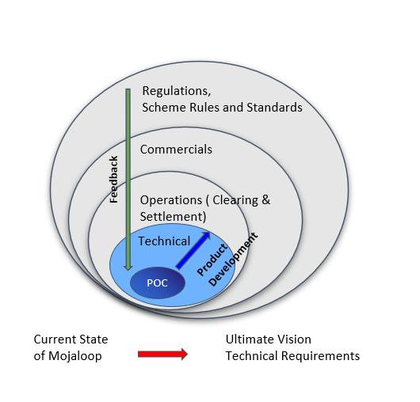
Key Considerations for Full-scale Implementation
Integration with Settlement System
Settlement Improvements (Single vs. Multiple Settlement Windows)
Business Operations Framework to support multi-currency operations
Interoperable Merchant Registry (QR Code)
FRMS Case Management and Transaction Monitoring
Dispute Management
ISO20022 Roadmap

Slide 12
Technical Considerations

Slide 13
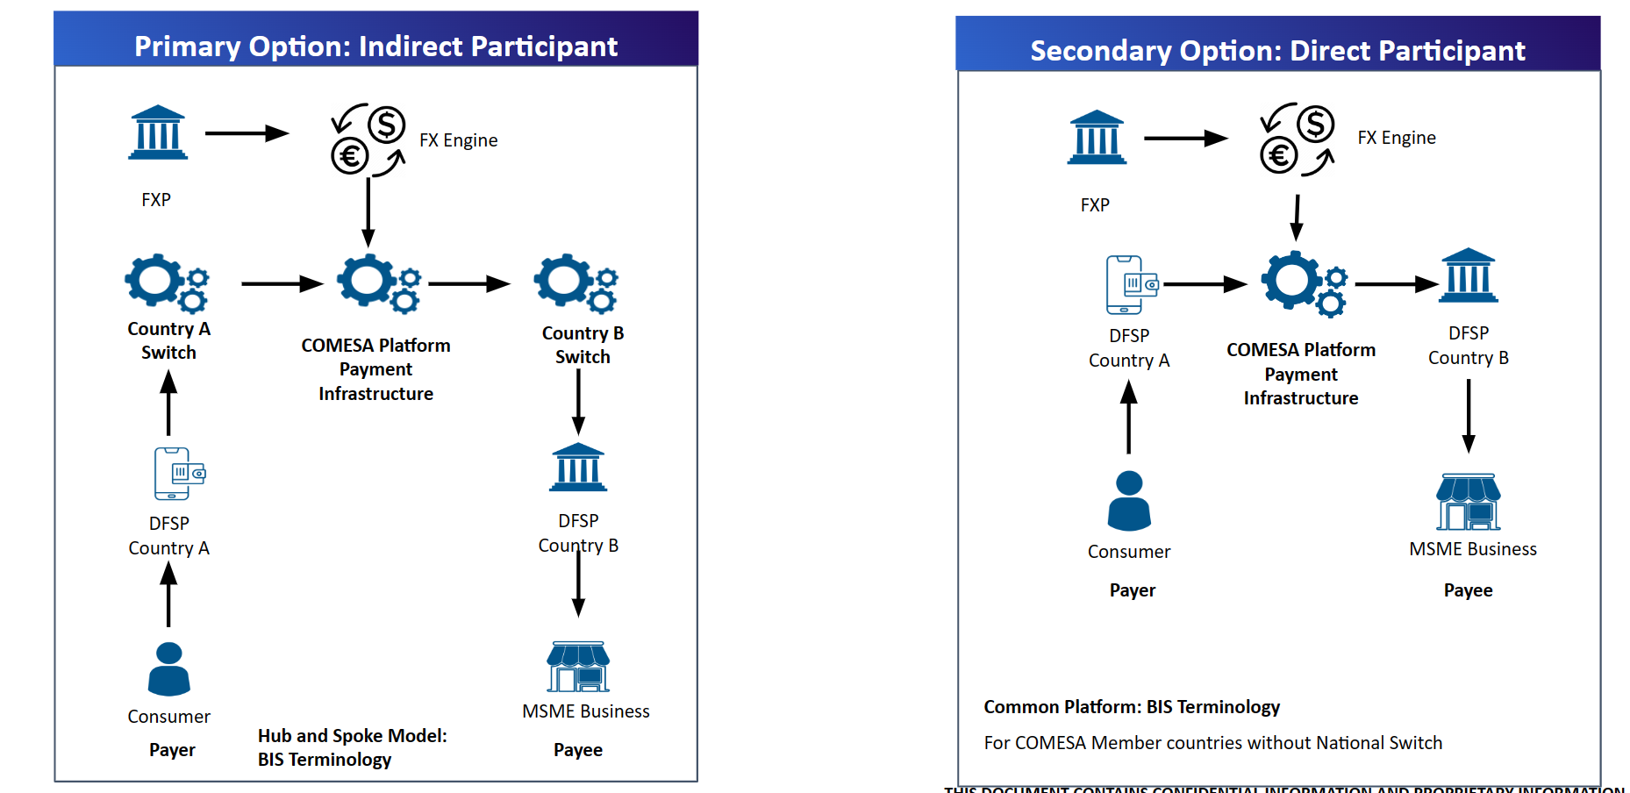
Integration Options

Slide 14
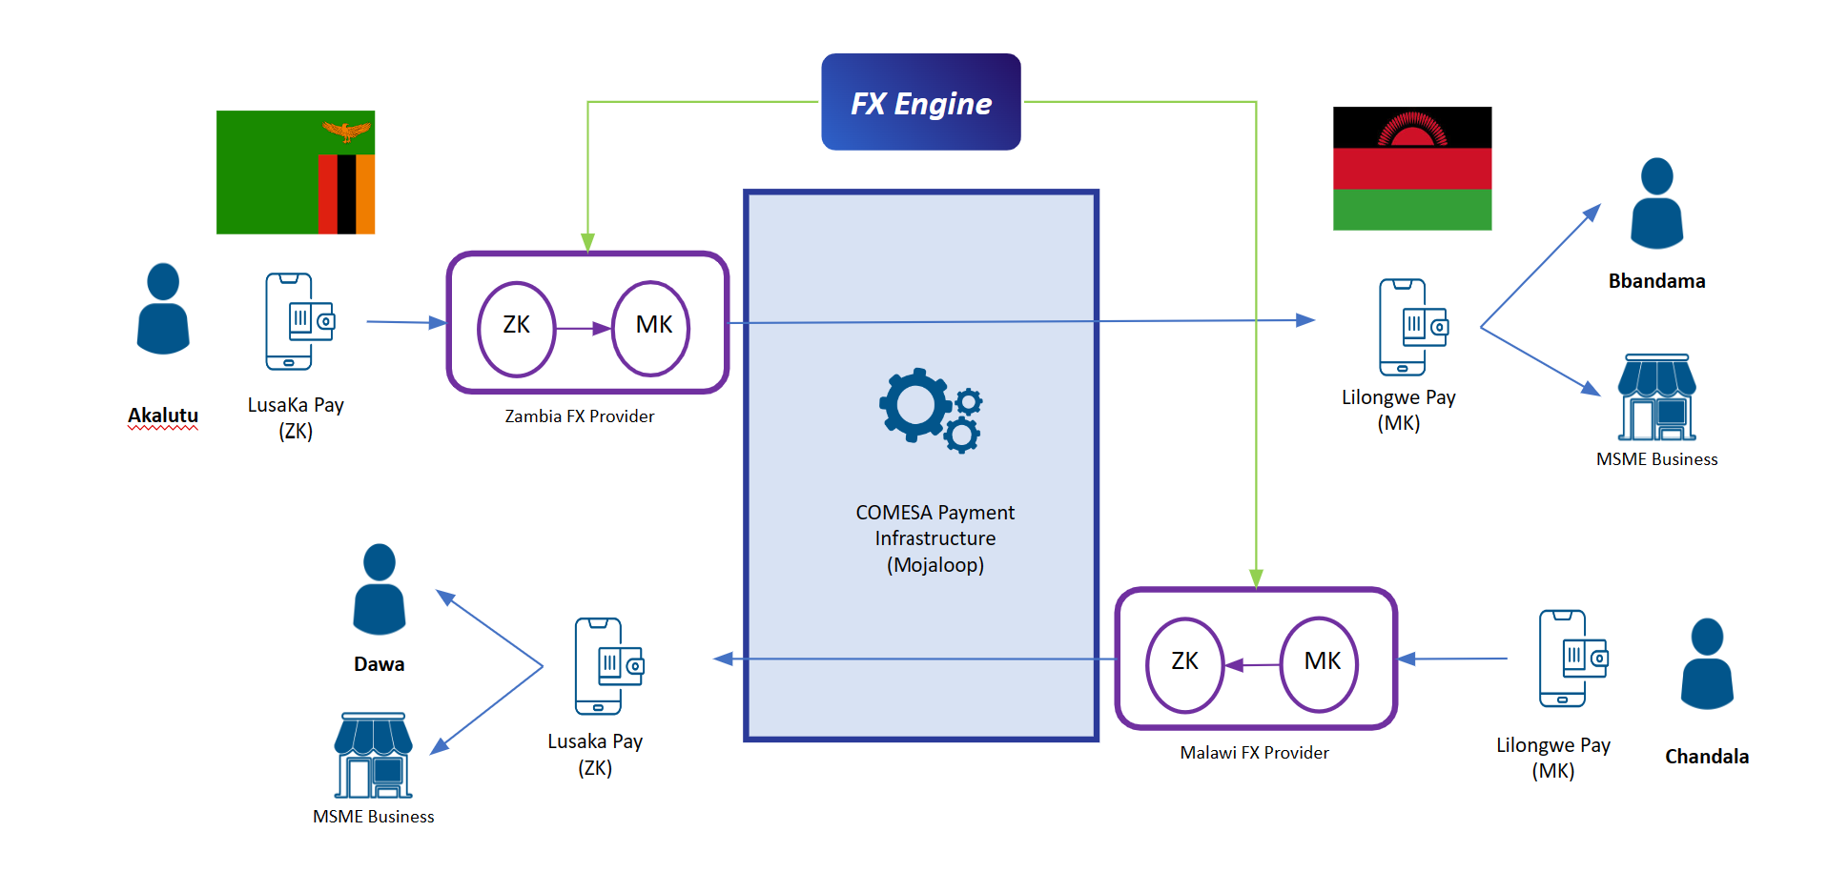
POC Design

Slide 15
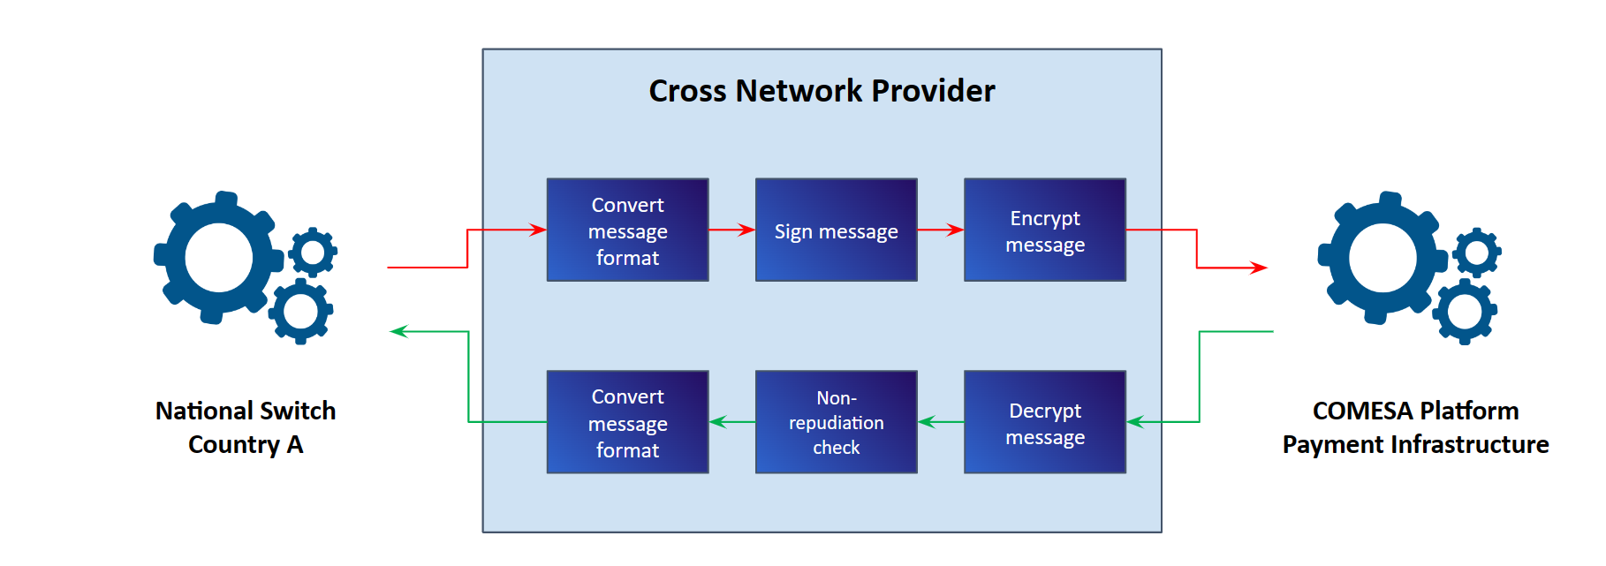
Cross Network Provider

Slide 16
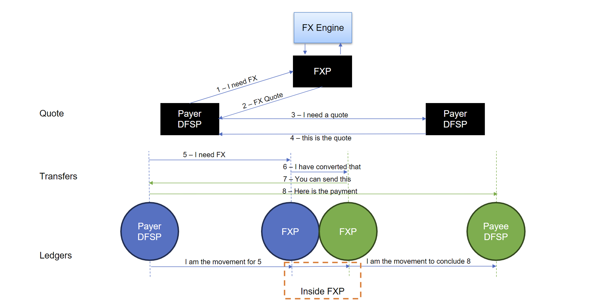
Currency Conversion Flow

Slide 17
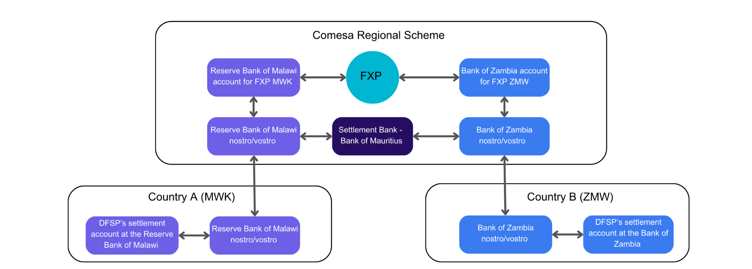
Potential Settlement Option (Cross Currency)

Slide 18
Additional Considerations
Knowns Unknowns, Unknown Unknowns
Choice of design on currency arrangement between multi-currency platform (where conversion happens outside of the platform) or cross-currency platform (where conversion happens within the platform).
Interdependency between settlement approach (e.g. multilateral deferred net settlement), number of settlement windows and impact on FX rate premium.
Flexibility on settling with local currency vs. reference currency, especially for corridors where cross-border trade is limited, resulting in limited currency-pair trading volume. Related issue is to determine (perhaps within the scheme rule book) which entity will be responsible for delivering.
Domestic exchange rate regime, capital controls policies, and any exchange restrictions imposed by local authorities.
Currency volatilities, and possible divergence between market rate and official exchange rate.
Regulatory reporting considerations and contracting counterparties

Slide 19
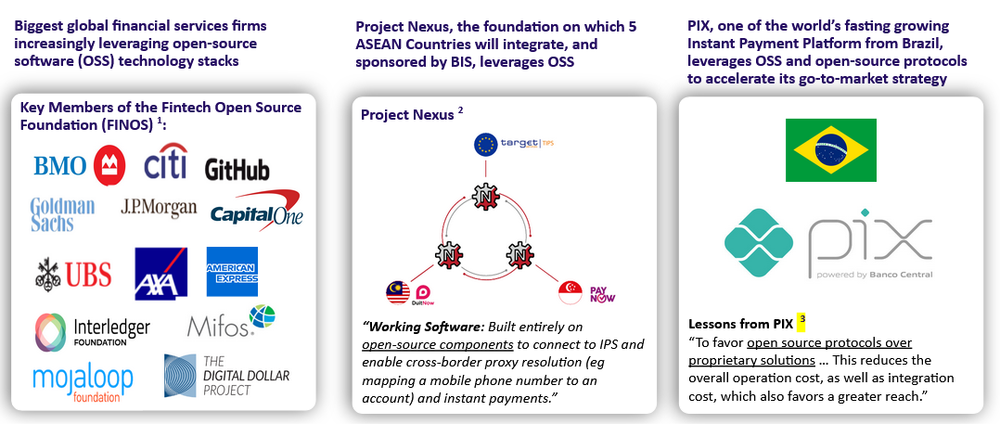
Strong momentum of Open Source

Slide 20
RECOMMENDATIONS

Slide 21
Recommendations
Engagement with Key Stakeholders: Ensure consistent communication with member countries, MSMEs, financial institutions, and FinTech companies. Recognizing the diverse nature of the COMESA region, it's crucial to tailor engagement strategies to the specific needs of each stakeholder group.
STAKEHOLDERS
Flexibility and Adaptability: A modular design will allow the system to integrate new technologies or adjust to regulatory changes without a complete overhaul. Given the rapid pace of digital transformation, such flexibility can be pivotal.
MODULAR
Advanced Cybersecurity Measures: Given the cross-border nature of transactions, the system should employ state-of-the-art encryption and multi-factor authentication to secure user data and funds.
SECURITY
INTEROPERABILITY
Standardized Data Protocols: Adopting standards like ISO20022 can ensure seamless transactions across borders and platforms, promoting a harmonized financial ecosystem within the COMESA region.
Real-time Monitoring: Implement real-time monitoring tools to swiftly detect issues, ensuring high uptime and reliable service delivery.
MONITOR KPI

Slide 22
Recommendations
Diverse Testing Environments: Given the diverse economic landscapes within COMESA, pilots should be run in varying economic conditions, ensuring the system's robustness.
EXPAND PILOT
Customized Training Modules: Recognize the varying levels of digital literacy within the region and create training modules suited to different user segments
BUILD CAPACITY
FINANCIAL MODEL
Budgetary Controls: Establish stringent controls to manage expenses and ensure optimal allocation of resources.
User-Centric Approach: Develop a user-friendly portal or platform where users can provide feedback, ensuring the system remains responsive to their needs.
FEEDBACK
Research and Development: Dedicate a team or department to monitor global trends in digital finance, ensuring the COMESA system remains at the forefront of innovation.
FUTURE PROOF

Slide 23
Recommendations
REGULATORY
Harmonized Policy Framework: Collaborate with policymakers across member countries to create a unified legal and regulatory framework, fostering a conducive environment for the payment system's success.
Establish a robust contractual framework that encompasses cross-border financial and settlement advisory services to facilitate seamless, secure, and compliant cross-border transactions by engaging experienced financial and legal experts to guide the development and implementation of this framework.
LEGAL
Infrastructure Investments: Anticipate future growth by investing in robust infrastructure that can handle increased transaction volumes and additional member country integrations.
SCALABILITY
Marketing Campaigns: Use multimedia campaigns, including social media, radio, and print, tailored to local cultures and languages, promoting the benefits and security features of the payment system.
AWARENESS
User Interface Design: Prioritize user-centric design principles, ensuring the platform is intuitive and accessible even for those with limited digital literacy.
USER EXPERIENCE

Slide 24
Q & A

Slide 25


Slide 26







COMESA Business Council
COMESA Centre, Ben Bella Road,
P.O. Box 3005, Lusaka, Zambia
Phone: +260 211 229725/32
Website: www.comesabusinesscouncil.org
Email: info@comesabusinesscouncil.org
@comesabusinesscouncil
@COMESABusiness
@COMESA Business Council
@comesa_business_council_1

